Slide 1

EARTH University:
Leadership for
Sustainable Development
Together we can make a difference

Slide 2
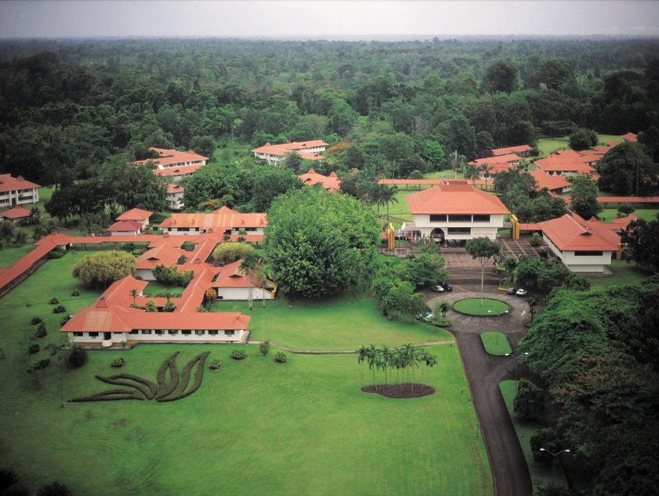
What is EARTH University?
An international, non-profit university in Costa Rica with an innovative four-year undergraduate program in agricultural sciences and natural resource management.

Slide 3
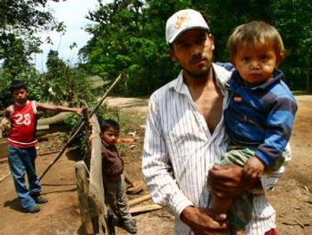
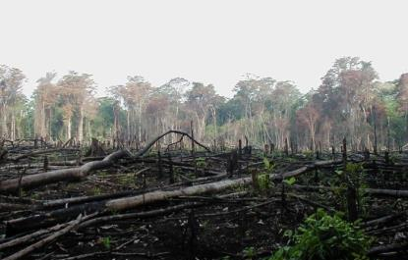
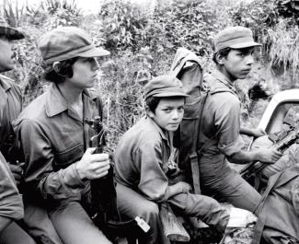
Our history
Rural poverty
Environmental
degradation
War
1980’s: Leaders in Costa Rica, USAID propose creation of EARTH
W.K. Kellogg Foundation finances feasibility study
1986: Costa Rican Congress passes law creating EARTH
USAID finances property, construction and endowment
1990: First class year

Slide 4
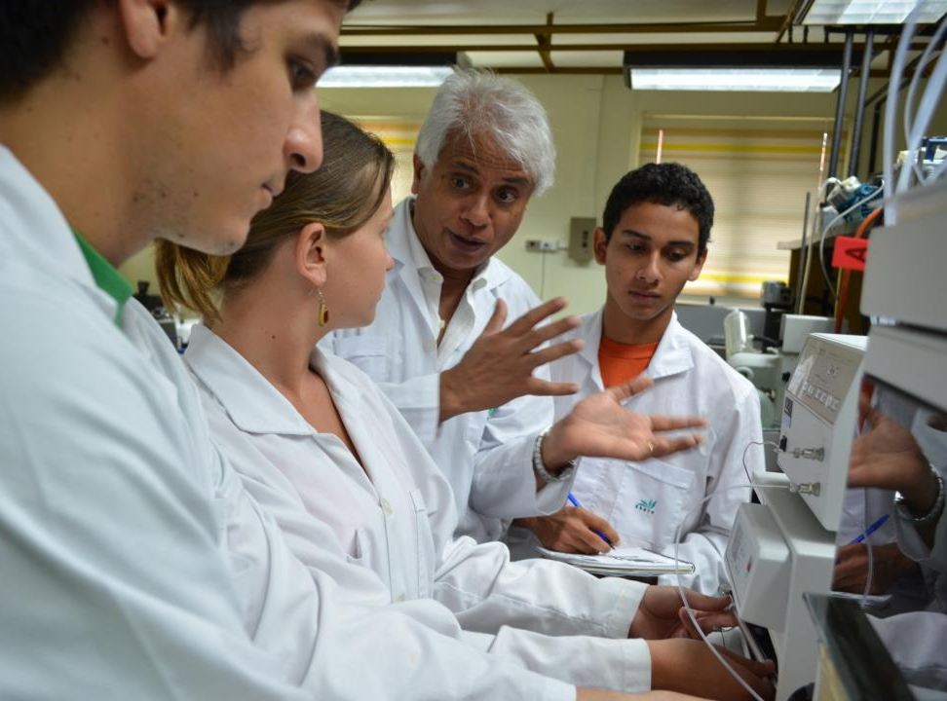
Our mission
Prepare leaders with ethical values to contribute to the sustainable development of the humid tropics and construct a prosperous and just society.

Slide 5
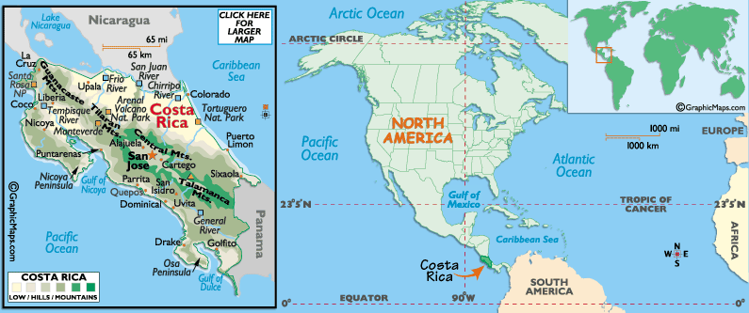
Where is EARTH?
EARTH-La Flor
Liberia, Guanacaste
EARTH University
Guácimo, Limón

Slide 6
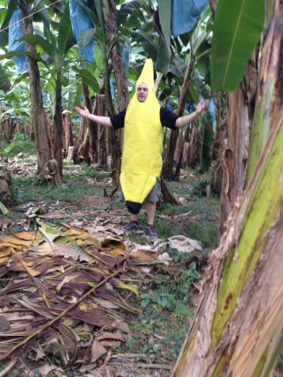
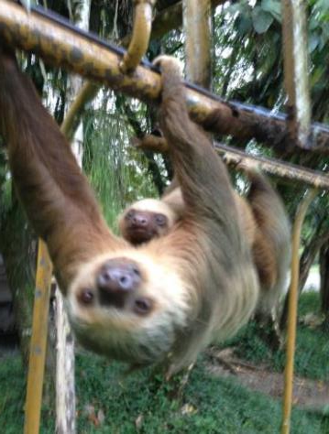
Special Guests

Slide 7
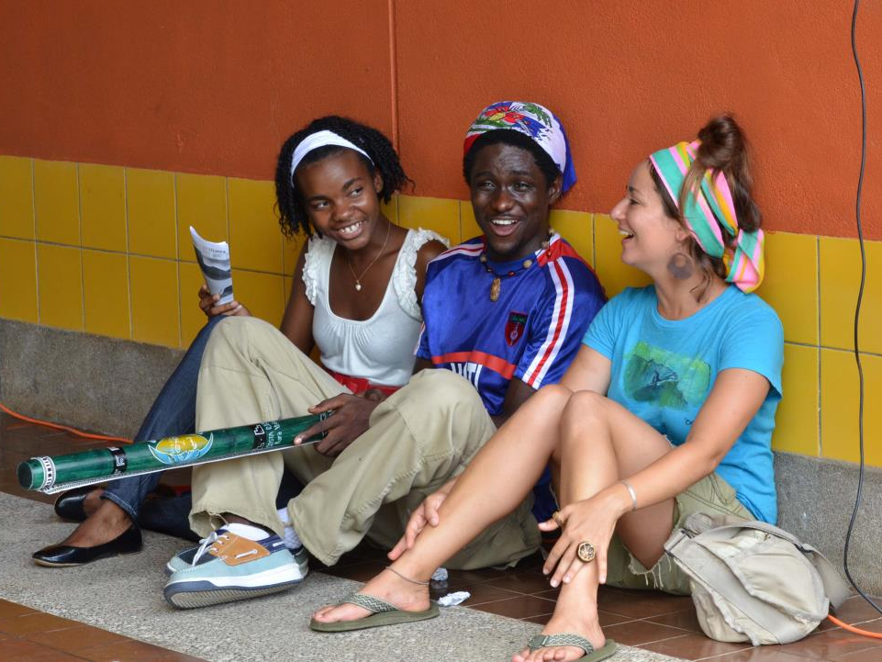
A global student body
410 from 29 countries
40% female
76% from rural areas
Highly-subsidized model with 60% on full scholarship

Slide 8
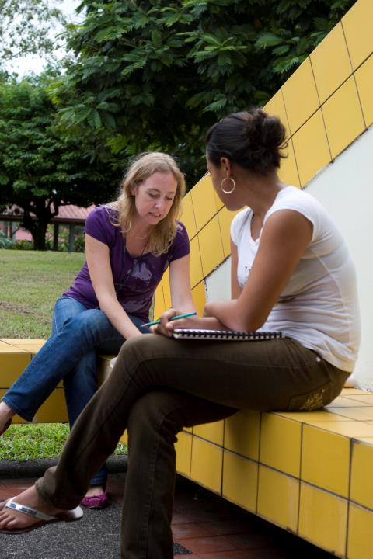
Our educational model
10:1 student/faculty ratio (40 faculty from 19 countries)
Faculty as facilitators
Integrated and multi-disciplinary
Student-centered learning
Experiential and participatory
4 formative areas:
  Technical & scientific knowledge
  Social and environmental awareness and commitment
  Values and ethics
  Entrepreneurship

Slide 9
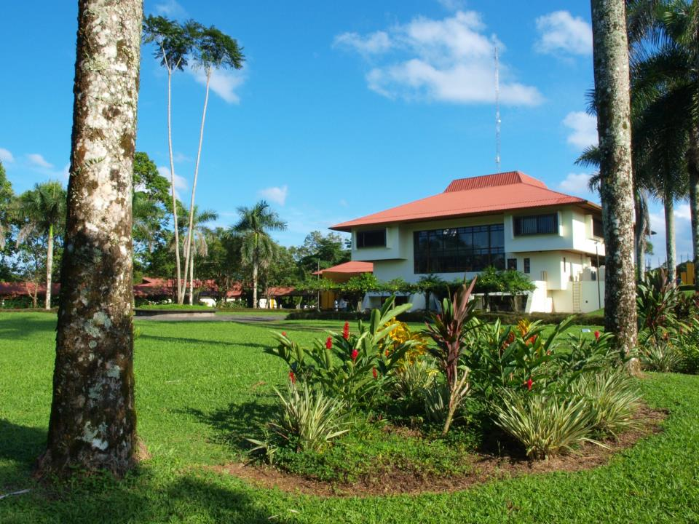

Slide 10
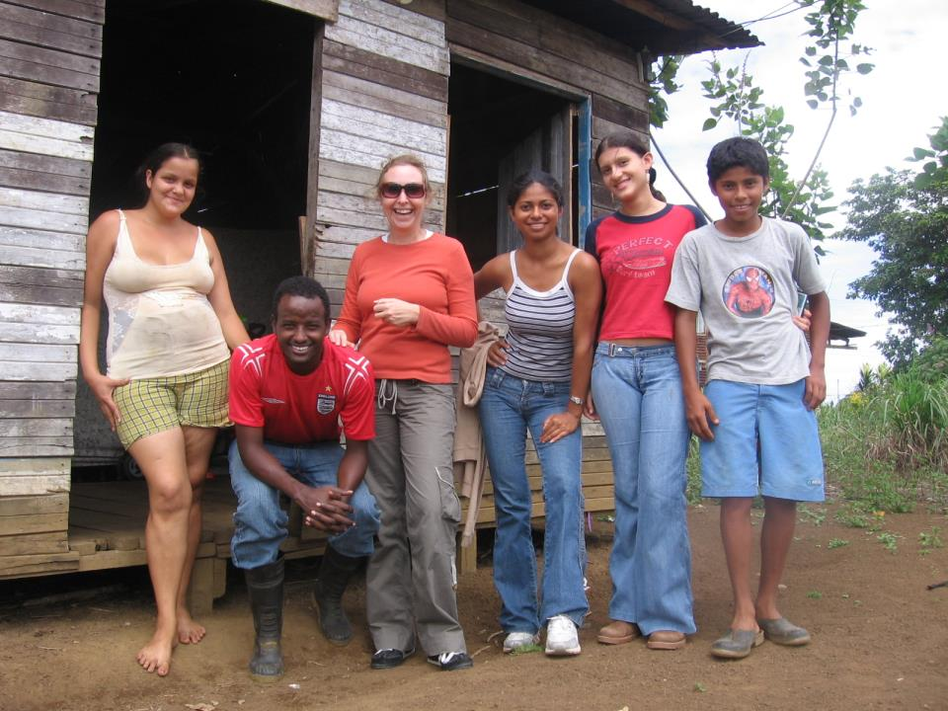
Social and environmental awareness
Social commitment:
  Community development program
  Experience at EARTH-La Flor
  Community development requirement during internship
  Environmental commitment:
  Sustainable agricultural systems
  Organic farming
  Carbon neutrality
  Waste management
  Alternative energy

Slide 11
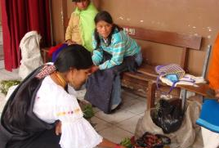
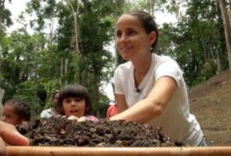
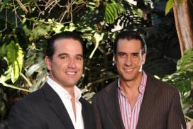
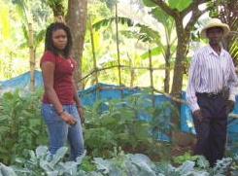
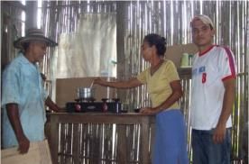
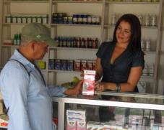
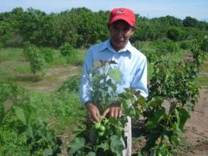
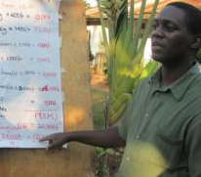
Alumni impact
1750 alumni from 28 countries
86% work in their country of origin
23% run their own or family business
75% social impact
62% environmental impact

Slide 12
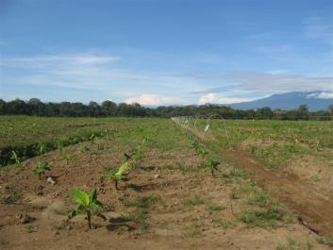
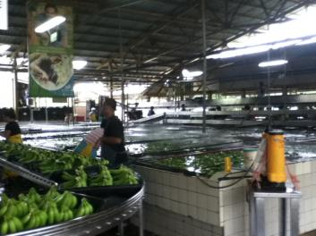
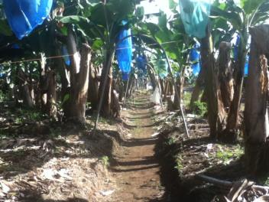
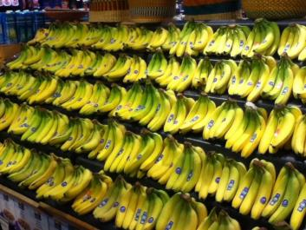
EARTH University Bananas

Slide 13

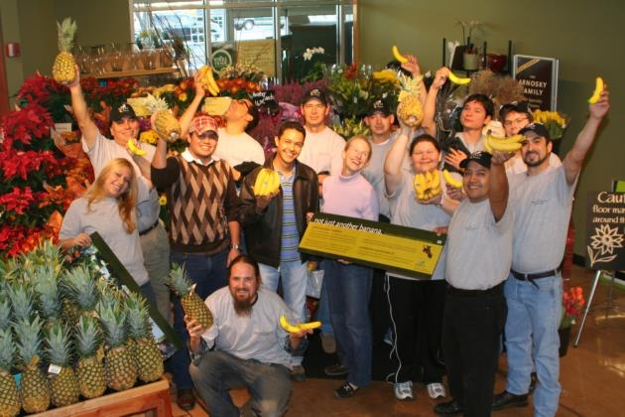
Partnership with Whole Foods Market
Advancing education, sustainable agriculture, and entrepreneurship in the tropics.

Slide 14
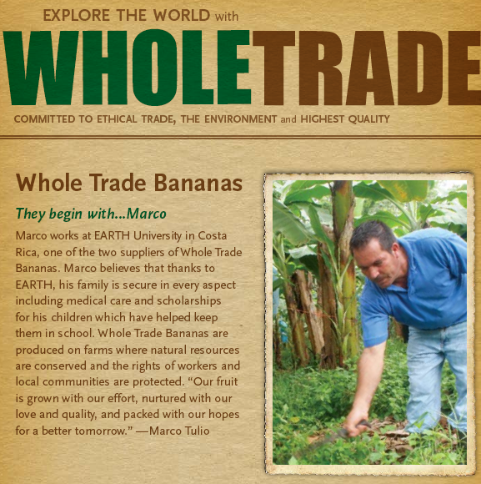

We are proud to be Whole Trade

Slide 15
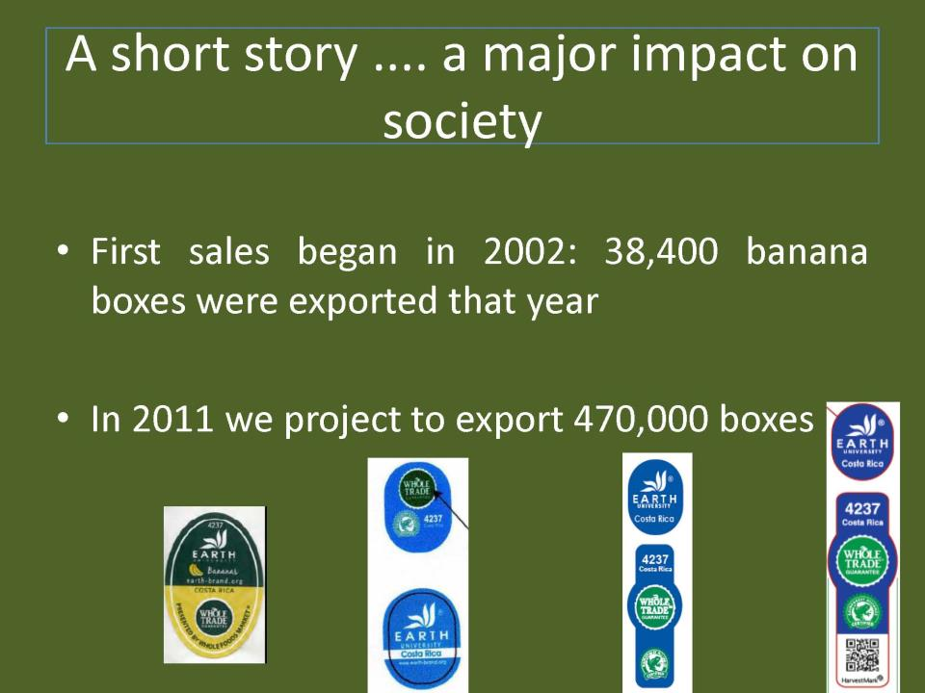

Slide 16


Partnership with Whole Foods Market
Not just about bananas…
It’s about creating sustainable wealth, environmental well-being and prosperity in the rural communities of the developing world.

Slide 17
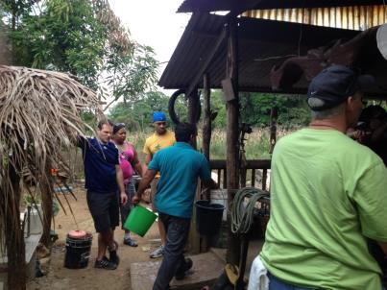
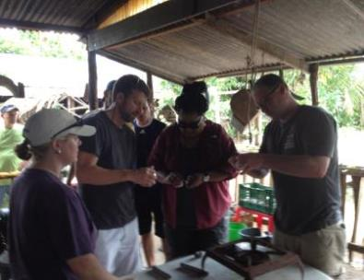
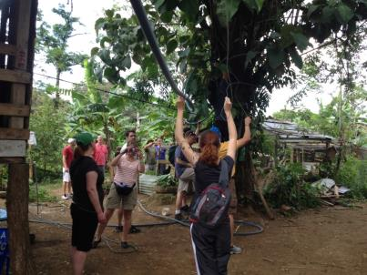
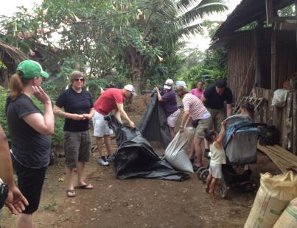

Slide 18
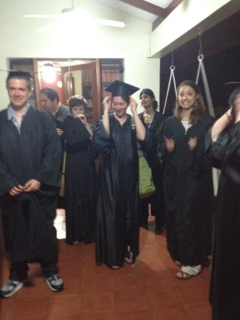
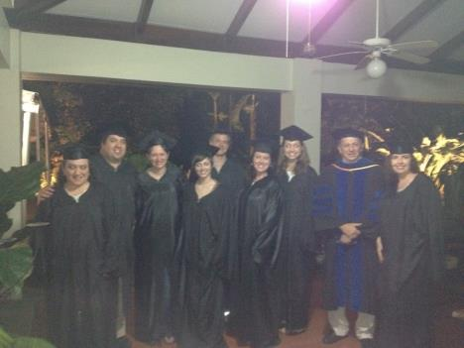
Become an EARTH Student

Slide 19
Earth’s Contributions to Our Planet
Educating Future Leaders
Building a Community Passionate About Environmental Sustainability
Conducting Research and Establishing Best Practices in Sustainable Agriculture
Being a Good Neighbor to Local Communities
Creating Partners that are Earth Stewards
Providing a Model of and Training in Carbon Neutrality (businesses and certifiers)

Slide 20
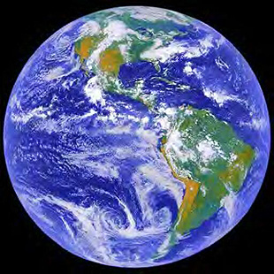
Thank You for Your Interest in Earth

